Slide 1
MISTI Presentation to OAPA
By Thomas Johnson, John Roscoe, Sam Schueth
USAID Washington DC, 10 August 2015

Slide 2
MISTI in a Nutshell
MISTI is a third-party evaluation and verification project designed to measure and map stabilization trends, evaluate USAID stabilization program impacts and performance, build a community of practice for rigorous monitoring and evaluation, verify project activity completion, and communicate lessons learned for creating sufficient stability for transition to Afghan-led sustainable development.
MISTI uses rigorous social science methods to evaluate the impacts of stabilization programs, and measure stabilization trends in key districts across the USG regional platforms outside Kabul.
3.5 years
$21 Million

Slide 3
MISTI Program Elements
MISTI Stabilization Trends and Impact Evaluation Survey
Five semi-annual surveys of between 36,000 and 41,000 household interviews each
One baseline and four stabilization trends and impact evaluation reports
Performance Evaluations
Nine stabilization project performance evaluations
Verifications
Just over 750 verifications completed
Online Verification Dashboard
Community of Practice
Quarterly M&E Summits (10)
Workshops (3)
MISTI Knowledge Management Portal
Three Peer Review Papers
Notes:
Performance evaluations focus on descriptive and normative questions: what a particular project or program has achieved (either at an intermediate point in execution or at the conclusion of an implementation period); how it is being implemented; how it is perceived and valued; whether expected results are occurring; and other questions that are pertinent to program design, management and operational decision making.

Slide 4
Bottom Line Up Front
The impacts of stabilization programming are highly dependent on local context.
Impacts were greatest in areas controlled or contested by the Taliban and smallest where GIRoA had full control.
Impacts in Taliban controlled villages are not well understood because projects were not designed to operate in areas that had not been cleared of insurgents.
Project activities attracted violent enemy actions. Coordination with security forces is essential for reducing risk to locals.
The 2014 presidential election crisis reduced impact.
Literacy and female empowerment are important areas of focus for reducing support for the Taliban.

Slide 5
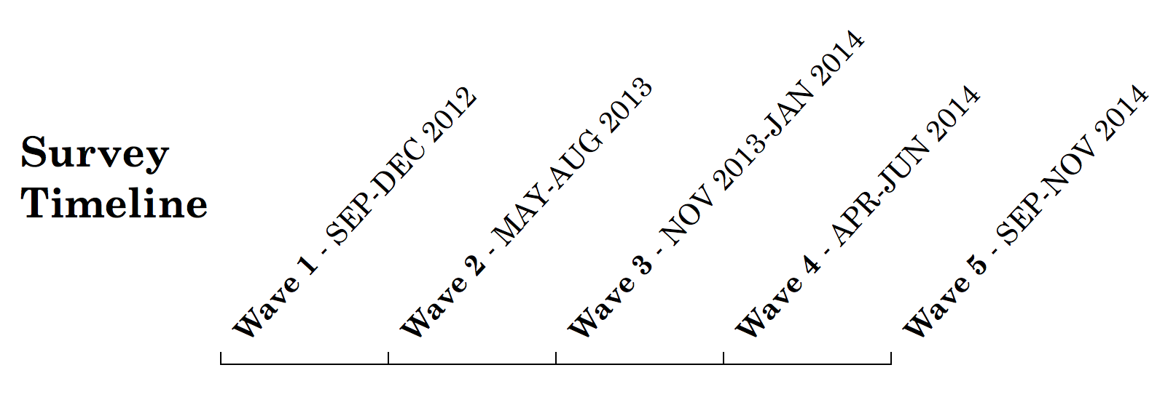
MISTI Survey: Key Facts
Village panel survey: 5 iterations (“waves”)
5,093 villages, 190,264 interviews
130 districts, 23 provinces
860 “treated” villages where stabilization projects took place (16.8% of total)
Quasi-experimental design, difference in differences (DID) method:
DID = Treatment_{0,1}*(Endline - Baseline) – Control_{0,1}*(Endline - Baseline)

Slide 6
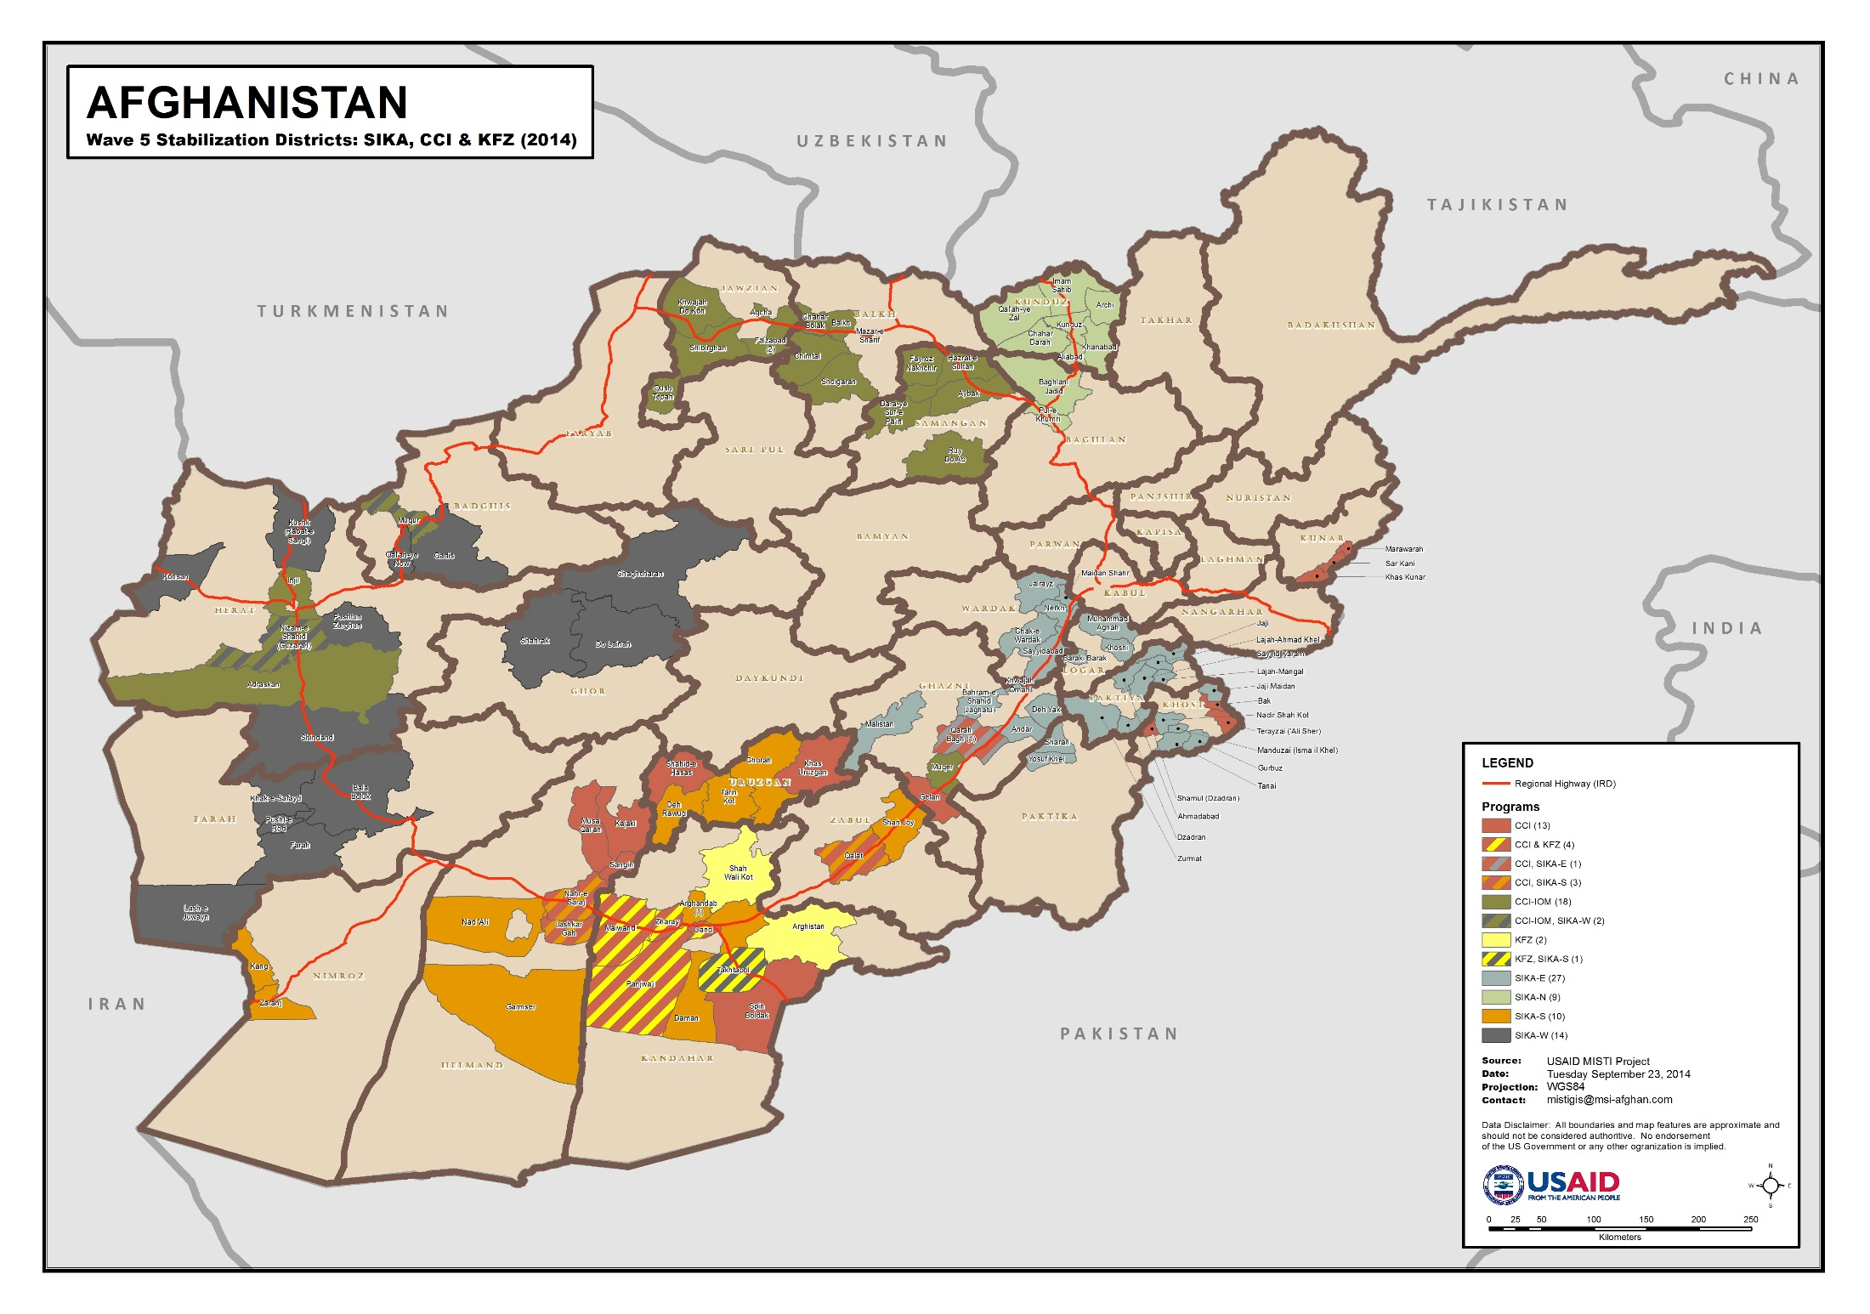
MISTI Survey Coverage (Wave 5)

Slide 7
Stability and Resilience Index Components
Provincial Government Performance
Government Capacity
District Government Performance
Stability
District Government Satisfaction
Local Governance
DDA-CDC Performance
Resilience
Quality of Life
Local Leader Performance
Social Capital
Community Cohesion
Local Leader Satisfaction
Notes:
Stability Index: 30 total survey items;
Resilience Index: 21 total survey items
District and Provincial Performance: Responsiveness, confidence, gets things done
Government Satisfaction: Understands local problems, visits the area, fairness, honesty, regarded positively
Quality of Life: Direction of district, security in local area, security trend, life satisfaction, household finances, ability to meet basic needs
Social Capital: Ability to solve external problems, ability to solve internal problems, how often villages work together
Local Leaders Satisfaction: Represents citizens interests, women’s interests, secure funding

Slide 8
Overall Stability and Resilience: Trends
Wave 1 Wave 2 Wave 3 Wave 4 Wave 5
Notes:
Waves 1-5 are the five semi-annual survey
At the overall level we see minor changes in stability and resilience levels. Can see the shift in levels influenced by the fighting season (April to October) in Waves 2 and 4. In Wave 5 levels to not rebound in the non-fighting season. This is likely due to the instability caused by the election crisis, delays in determining the composition of the Ghani government, and prolonged fighting season.
Hyperbolic curve charts: Width of base shows variation in district responses…the wider the base the greater the variation. If curve moves to the left we have a deterioration in the stability/resilience Index score.
Stability curve: W5 has wider base (greater variation in district scores) with most change to the left (deterioration). From this we can drill down in the data to identify which districts have slipped to the left. Also we should explore each of the components of the stability index to identify if any particular dimensions of stability are deteriorating at a faster level in the worsening districts. This will help identify which districts to program in and what dimension of stability the programming should be focused on, e.g., governance, security, local economy, etc.
Resilience curve: Resilience score fairly static across the survey waves. Peaked in W3. Flat between W4 and W5. Variation has narrowed to the left. From this we can drill down in the data to identify which districts have deteriorated. We can also explore components of the resilience index to identify which dimensions of resilience are deteriorating in the worsening districts. This will help us to better plan programming by location and type of activity.

Slide 9
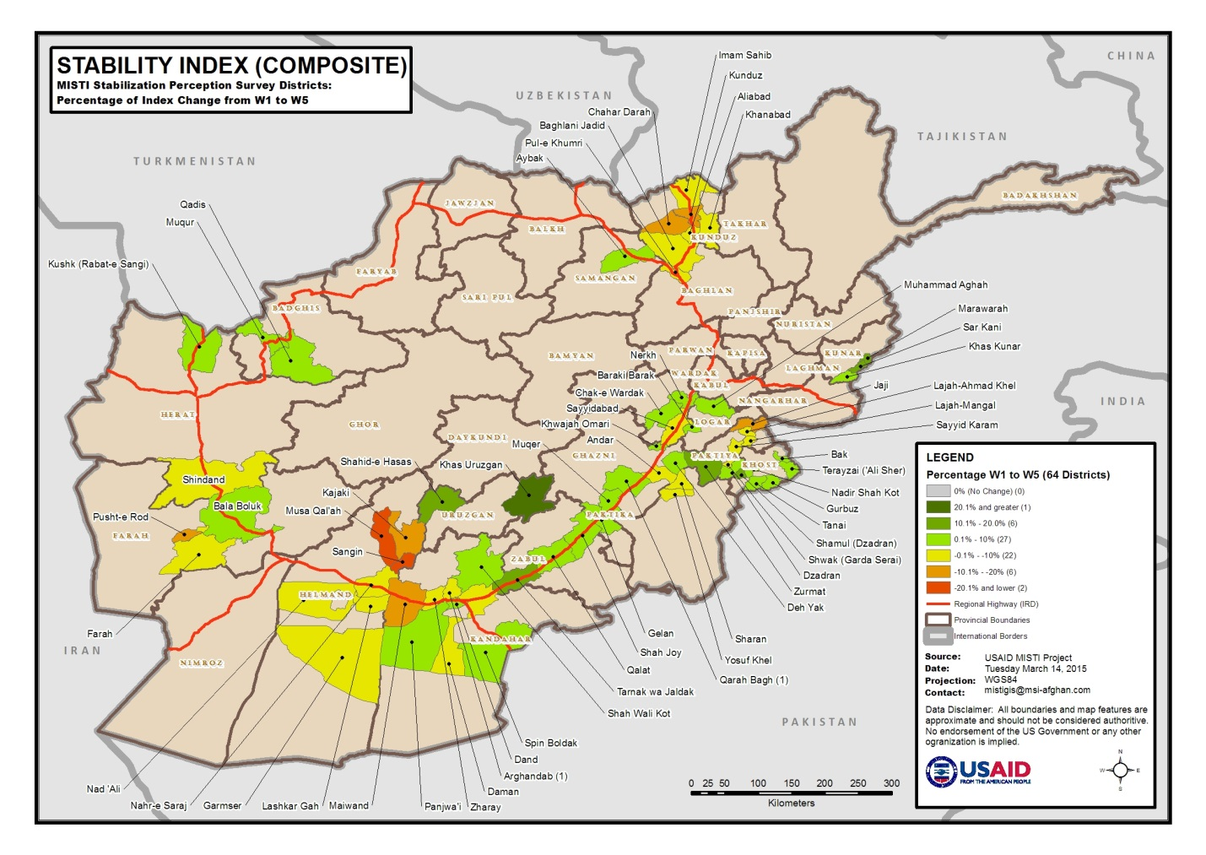

Slide 10
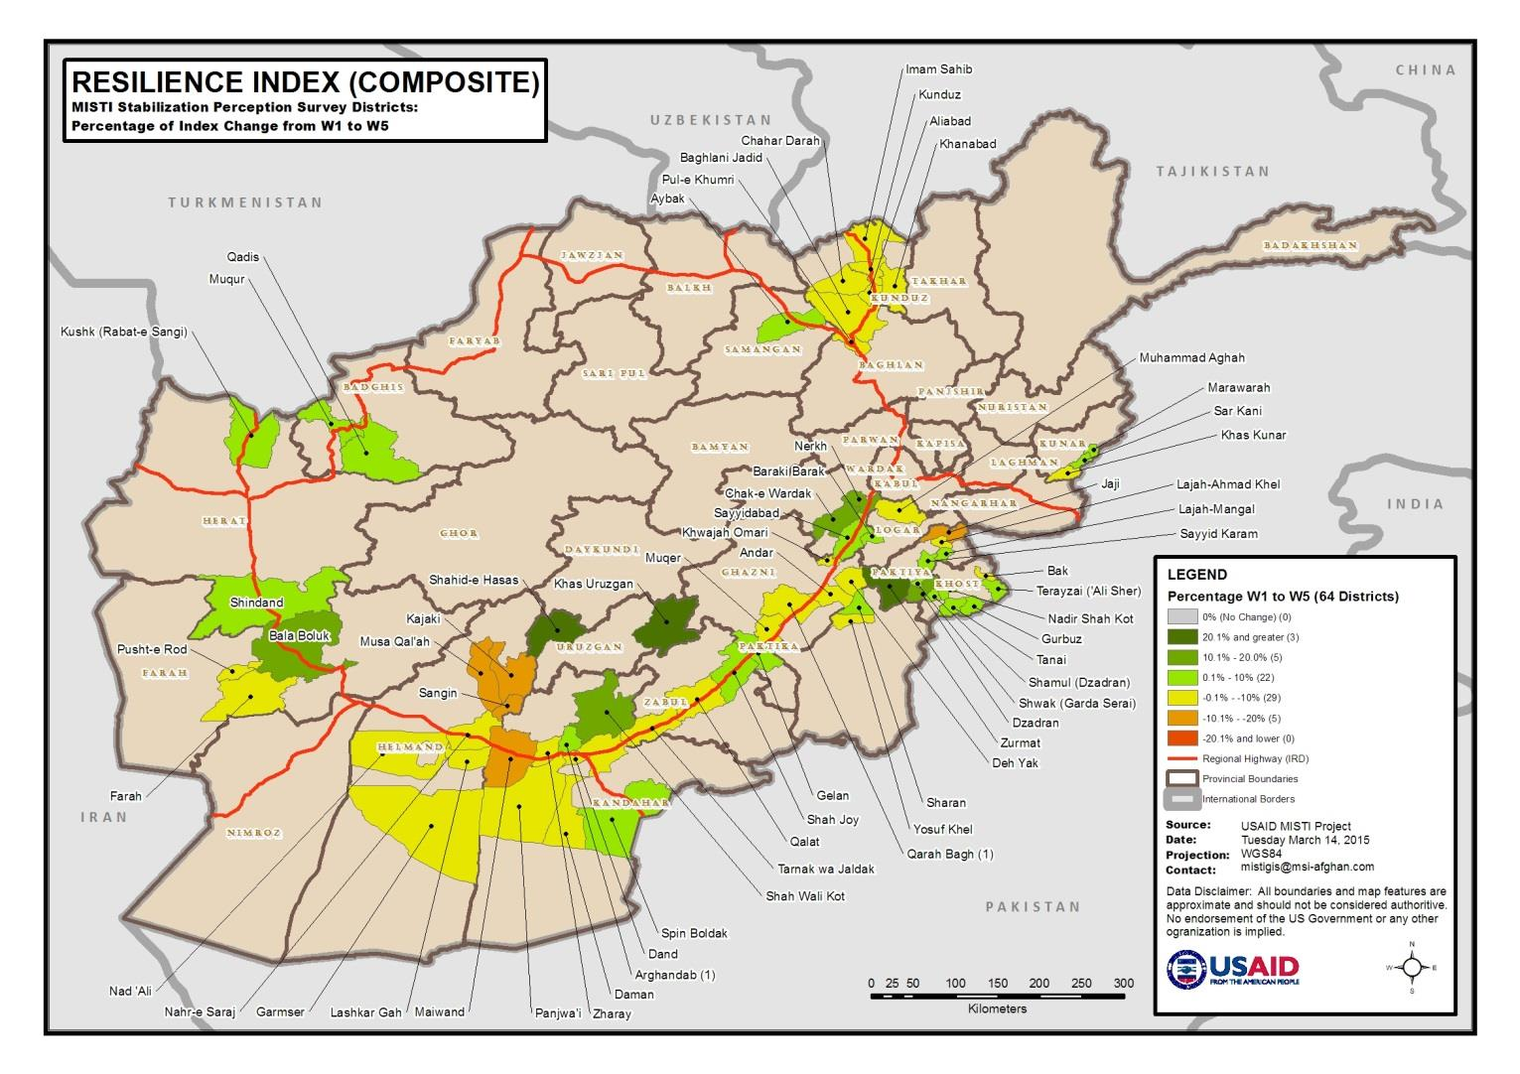

Slide 11
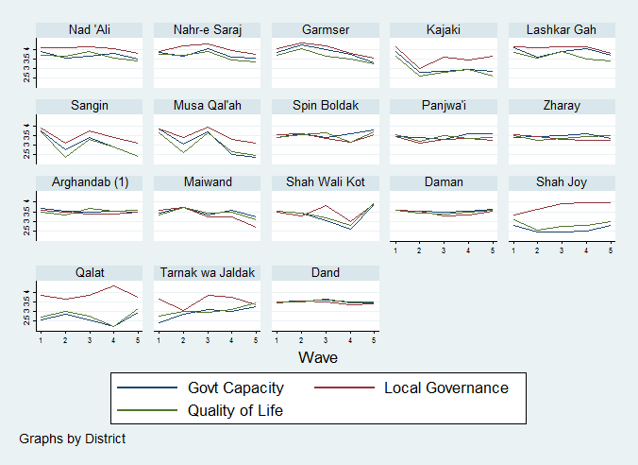
Differences more apparent as the data is broken down
Stability Components South Region: By District
Notes:
The more we breakdown the data, the greater the variation in results. Trends are smoothed out at the overall and regional levels but we see significant differences at the district level and among the different components of stability. We can break the data all the way down to the village level and sub-components (individual questions in the indices).

Slide 12
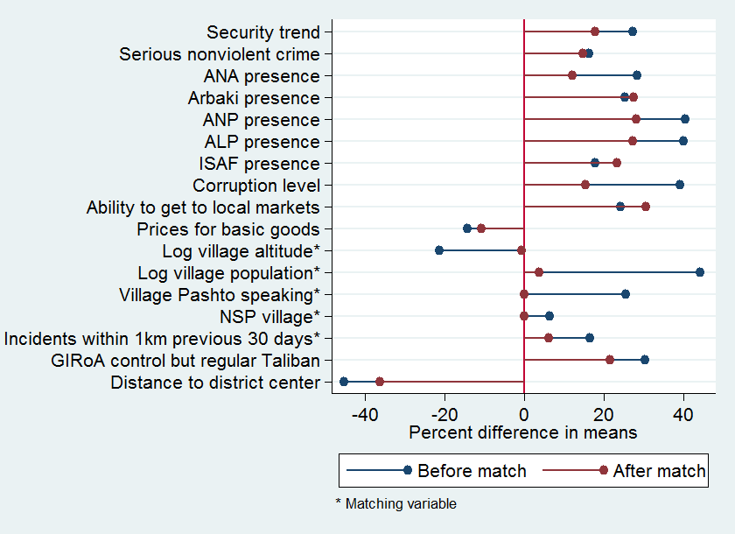
Village Matching to Create the Counterfactual

Slide 13
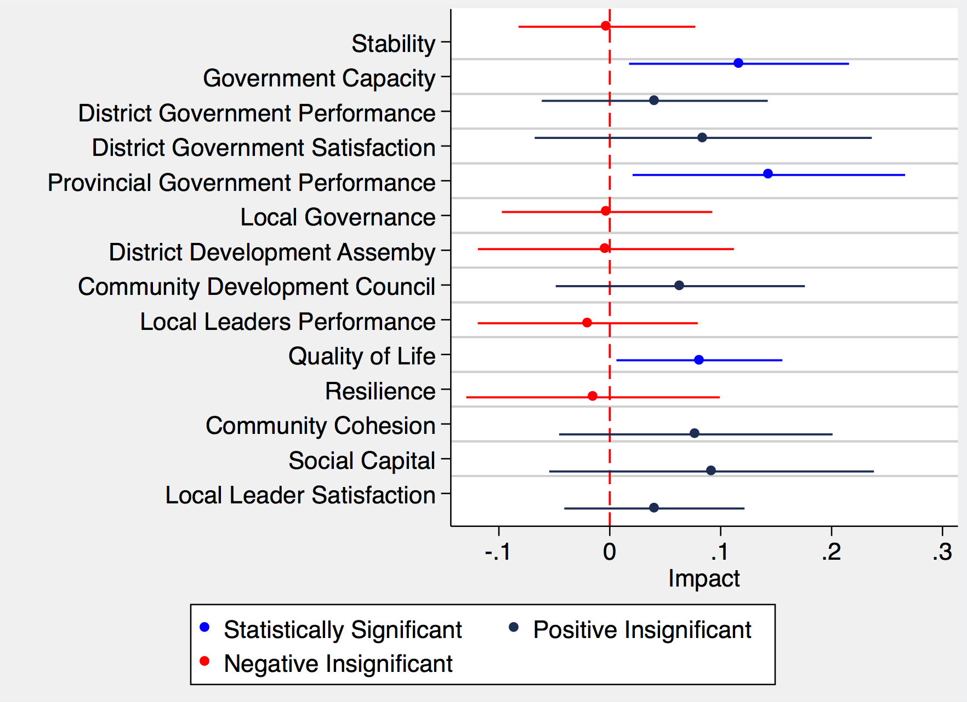
Summative Impact Evaluation Findings: One-Year Impacts
Notes:
Key findings:
The figure shows the one-year Impacts of stabilization project activities on all components of the Stability and Resilience Indices. Stabilization programming had statistically significant impacts on Government Capacity, Provincial Government Performance, and Quality of Life only. The other treatment effects are considered statistically insignificant (equal to zero) at the 95% confidence level.
Positive effects that were too small to reach the threshold of statistical significance were found on District Government Performance, District Government Satisfaction, Community Development Council, Community Cohesion, Social Capital, and Local Leader Satisfaction. Negative but insignificant effects were found on Overall Stability, Local Governance, District Development Assembly, Local Leaders Performance, and Resilience.
Technical explanation of the models:
These findings are summative such that they combine three one-year measurements from all villages surveyed in Waves 1-3, 2-4, and 3-5. The unit of analysis is a village-year. There are 362 total treated villages (unique village-years) included in the time series. These are matched to 3,177 control village-years using an index variable to confine the matching of treated villages with control villages from the same year. After matching, 150-170 treated and 300-400 control village-years remain in each impact model. The point estimate of each effect is displayed by a circle on the graph. The lines on either side of the circles show the 95% confidence interval around each point estimate. That is, 95 out of 100 repetitions of the impact evaluation would give us an estimate at some point on the line that intersects each circle. The dashed red line marks the zero point on the x-axis. Where a blue line crosses the dashed red line, the treatment effect is considered statistically insignificant.

Slide 14
Territorial Control of Project Villages
Taliban <----------------------------------------> GIRoA
Notes:
In fact the SIKA and CCI programs operated in villages that were not cleared of Taliban. This slide shows the number of surveyed villages where stabilization activities took place in five different zones of territorial control.

Slide 15
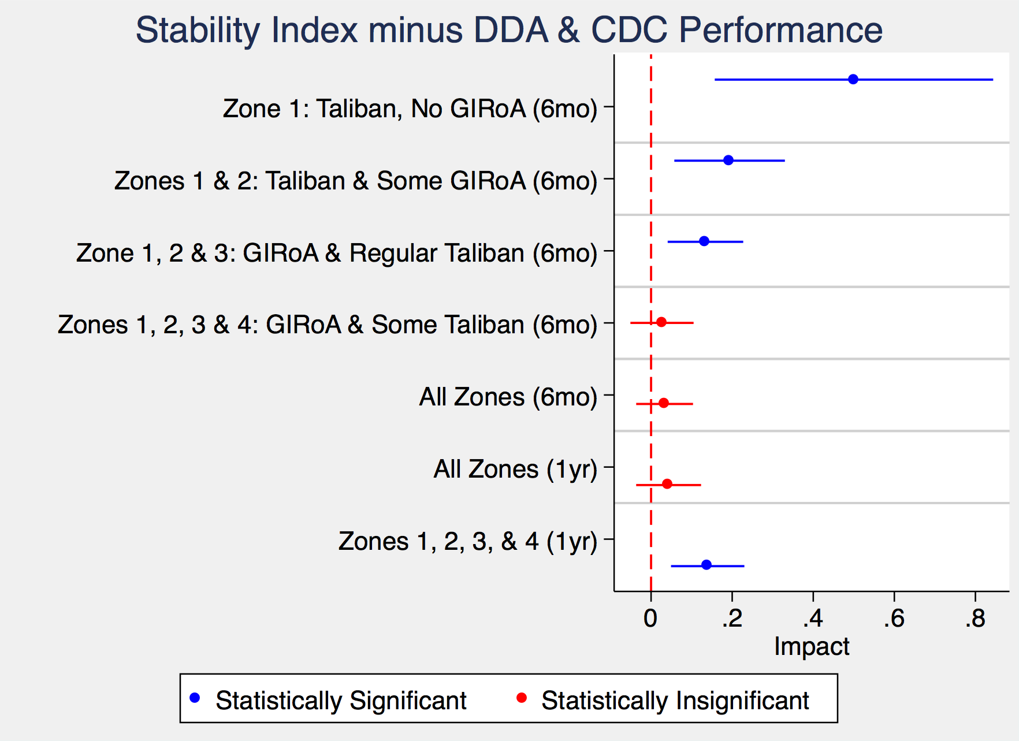
Stabilization Impacts by Zone of Territorial Control
Notes:
Key findings:
The figure shows the impacts of stabilization programming on overall stability disaggregated by Zone of Control (see previous slide). The blue markers on the graph show positive, statistically significant impacts. The red markers show effects that are positive but too small for statistical significance. The disaggregation by zone shows that impacts were greatest in villages that were partially or wholly outside the control of GIRoA. The effect of projects on overall stability is insignificant when villages fully under government control (Zone 5) are included in the impact models. These findings suggest that stabilization programming has the greatest impact in areas where the government has the least control.
From the top of the graph down:
The 6-month models found the biggest impact in Zone 1, which includes only villages fully controlled by the Taliban with no GIRoA presence (small sample of 18 treated and 24 control).
6-month impact is seen when the villages in Zones 1 and 2 were included in one model where the Taliban is in control with some GIRoA presence.
6-month impact was seen when the evaluation included Zones 1, 2, and 3 where neither the Taliban or GIRoA had complete control.
No significant impact was seen when the 6-month model included all the villages in Zones 1, 2, 3, & 4.
No significant impact was seen when the 6-month model included all the villages in all Zones 1-5.
No significant impact was seen when the 1-year model included all the villages in all Zones 1-5.
The 1-year model showed significant impact when villages in Zones 1, 2, 3, & 4 were included, and the ones under full government control in Zone 5 were excluded.
Technical explanation of the models:
The 6-month treatment effects combine measurements for all villages where a baseline measurement took place in one wave, then a project took place in the village (treatment), and an endline measurement took place in the next wave. Thus, the 6 month impact model tests for impact among the villages that received projects between Survey Waves 1-2, 2-3, 3-4, and 4-5. Likewise the 1-year treatment effects combine measurements from Waves 1-3, 2-4, and 3-5. Treatment effects are shown on the Stability Index excluding the DDA and CDC Performance Sub-Indices. Excluding the DDA-CDC Sub-Index removes the effect of poor perceptions of DDAs and CDCs on stability and allows for the inclusion in the impact evaluation of those villages where no DDA or CDC had been established. The point estimate of each treatment effect is displayed by the circles on the graph. The lines on either side of the circles show the 95% confidence interval around each point estimate. That is, 95 out of 100 repetitions of the impact evaluation would give us an estimate located somewhere on the solid line that intersects each circle. The dashed red line marks the zero point on the x-axis. Where a line crosses the dashed red line, the treatment effect is considered statistically insignificant. The 95% confidence interval is larger (the lines are longer) where fewer villages had projects in a particular Zone of Control, e.g. Zones 1.

Slide 16
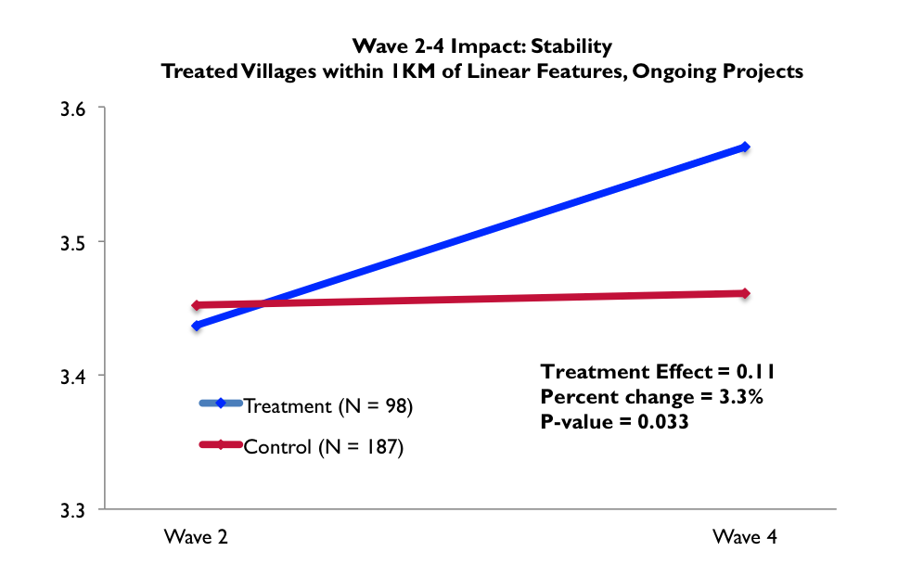
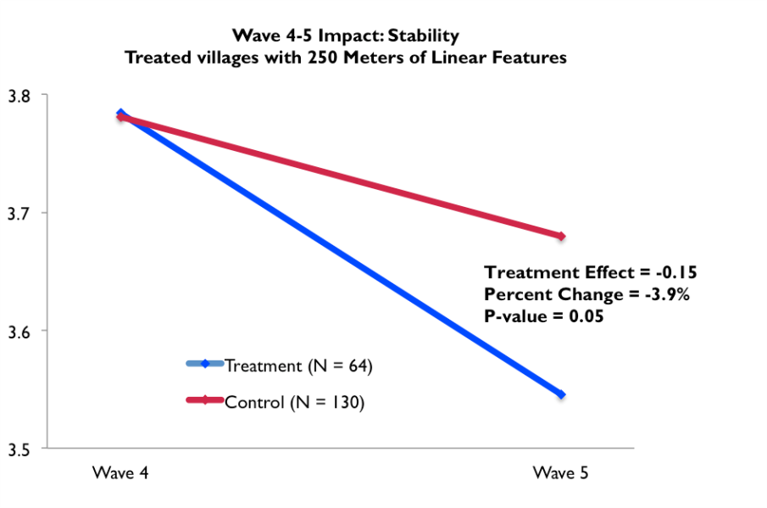
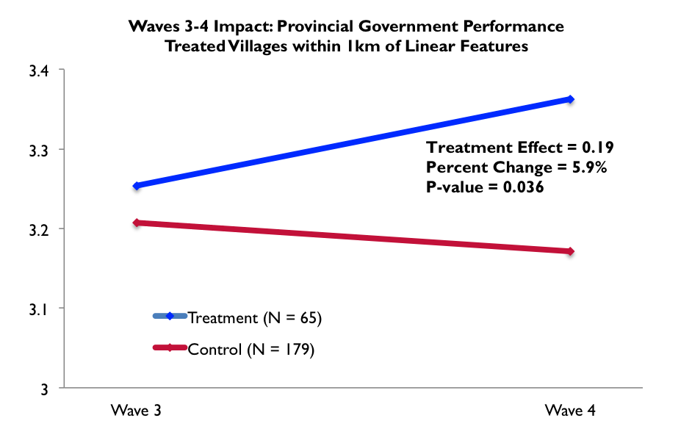
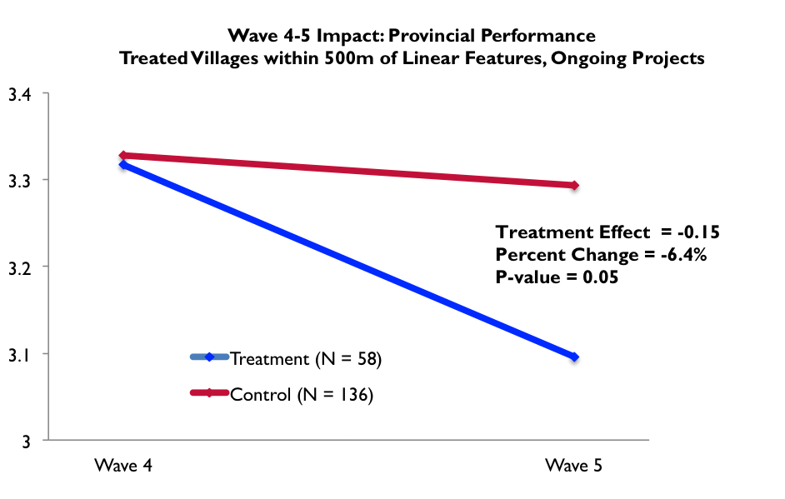
Impact of USAID Stabilization Programming
Notes:
The figures illustrate the impacts of stabilization programming as follows:
The positive impact of ongoing project activities on overall stability over one year from Waves 2-4 (top left);
The negative impact of project activities on overall stability over six months from Waves 4-5 (top right);
The positive impact of project activities on Provincial Government Performance over six months from Waves 3-4 (bottom right).
The negative impact of project activities on Provincial Government Performance over six months from Waves 4-5 (bottom left);
The figures show that positive impacts in Waves 2-4 and 3-4 reversed direction and became negative impacts in Waves 4-5. Also the baseline value on the Stability and Provincial Government The baseline value for the indicators was much higher the Waves 4-5 figures (top and bottom right) relative to the Waves 2-4 and 3-4 figures (top and bottom left). These findings suggest the following: 1) The uncertainty surrounding the 2014 presidential election crisis that spanned the June-September period between Waves 4-5 resulted in a substantial change in the context of stabilization programming such that strengthening connections between villages and the government through project activities was perceived as destabilizing. 2) Expectations for stabilization programming reached a high point by Wave 4. These expectations were not met by the projects implemented before the Wave 5 endline survey. Implementation delays due to USAID vetting of CDC and DDA members was a source of negative impact. Vetting also led to the implementation of projects that were not prioritized locally but were implemented because they were under the $25,000 vetting threshold.

Slide 17
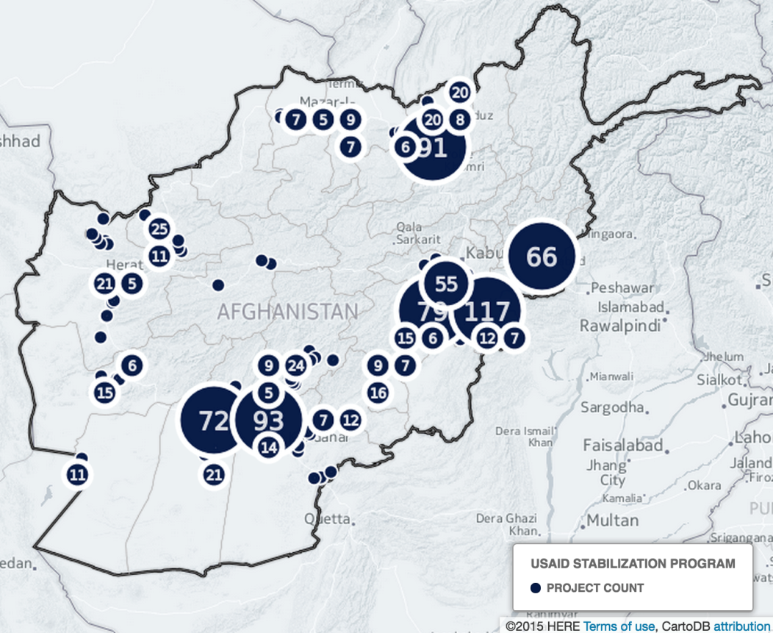
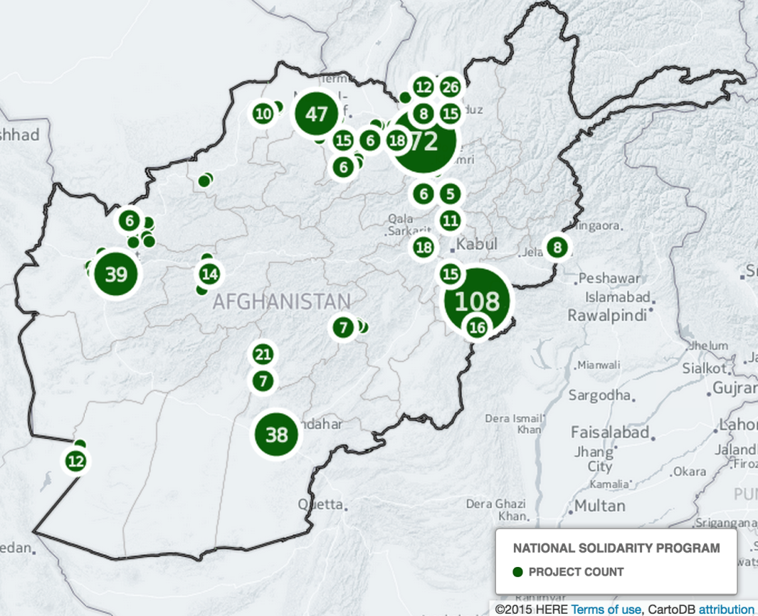
Count of USAID Interventions that took place in Surveyed Villages
Count of NSP Interventions that took place in Surveyed Villages

Slide 18
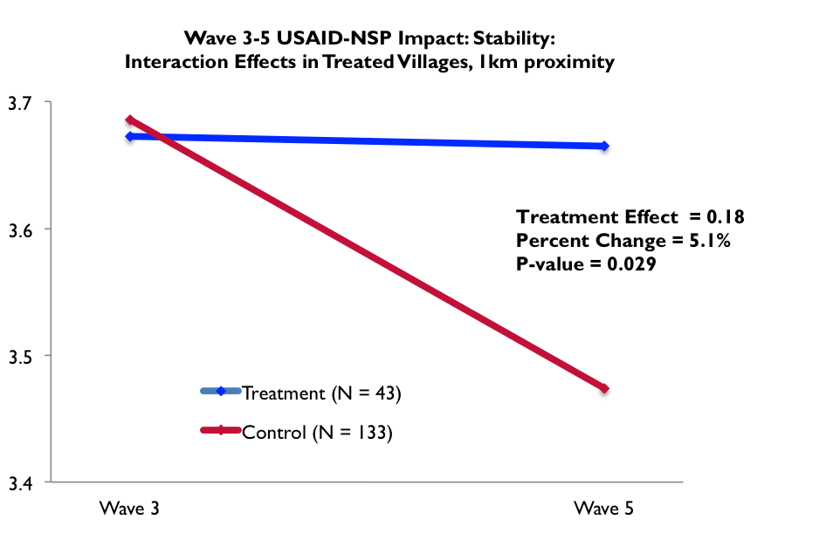
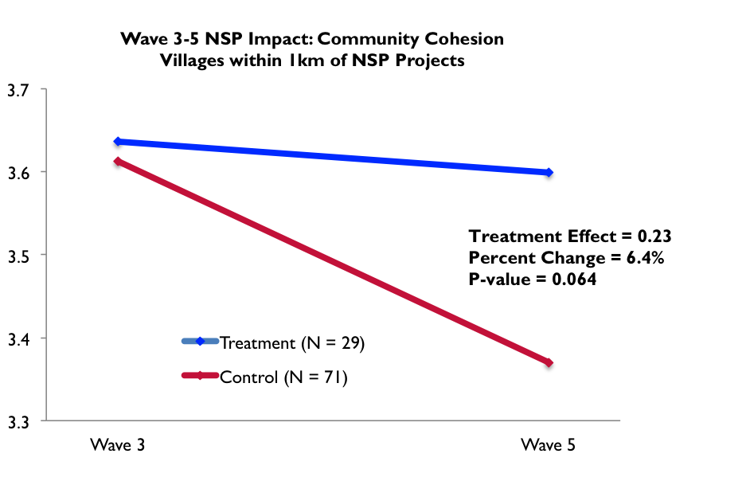
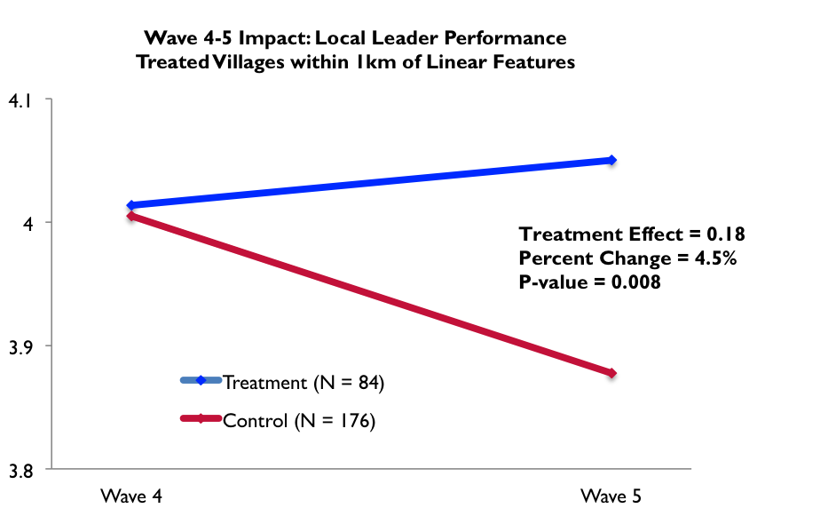
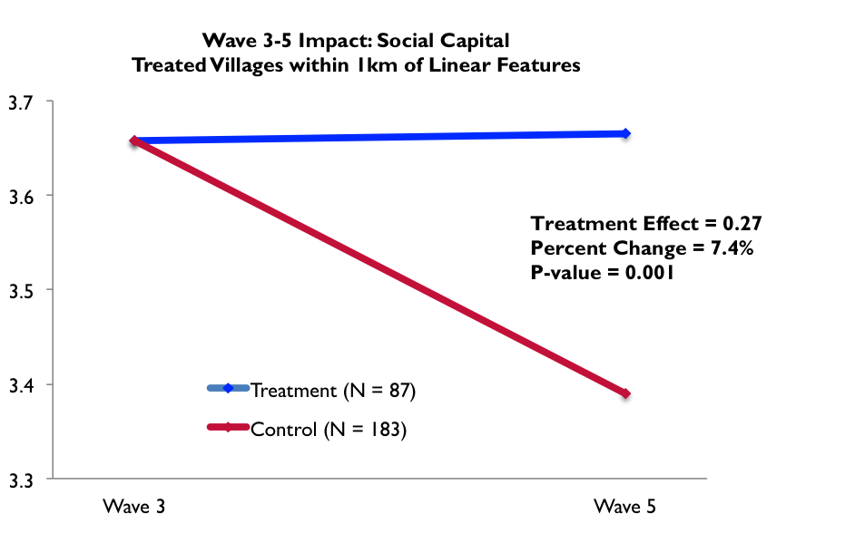
Impact of USAID and NSP Stabilization Programming
Notes:
The figures illustrate the impacts of USAID and NSP programming as follows:
The positive impact of NSP and USAID programming on overall stability over one year from Waves 3-5 (top left);
The positive impact of NSP programming on Community Cohesion over one year from Waves 3-5 (top right);
The positive impact of USAID programming on Local Leader Performance over six months from Waves 4-5 (bottom right).
The positive impact of project activities on Social Capital over one year from Waves 3-5 (bottom left);
These findings illustrate that the positive impacts found in Waves 3-5 and 4-5 resulted when a village received activities from both NSP and USAID. Similarly positive impacts were seen in villages where USAID implemented both “hard” and “soft” activities. This finding suggests that “hard” infrastructure projects alone are not sufficient, stabilization also requires “soft” activities that promote community organization. USAID stabilization had positive impacts on Local Leader Performance and Social Capital and negative impacts on DDA-CDC Performance. This finding suggests that local leaders were credited with the benefits of stabilization programming instead of DDAs and CDCs.

Slide 19
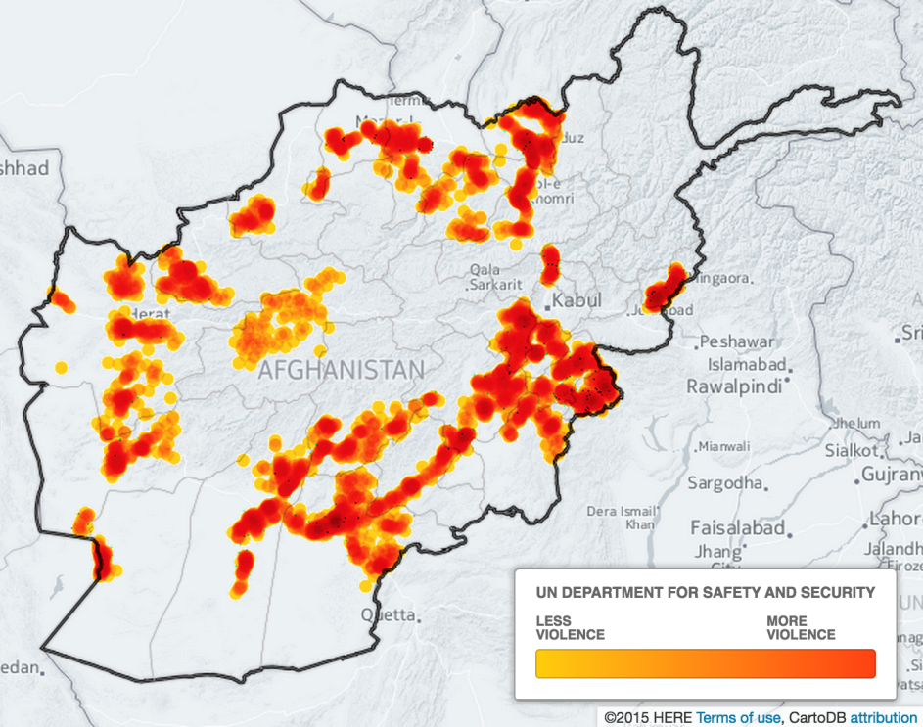
Intensity of Violent Incidents in Vicinity of Surveyed Villages

Slide 20
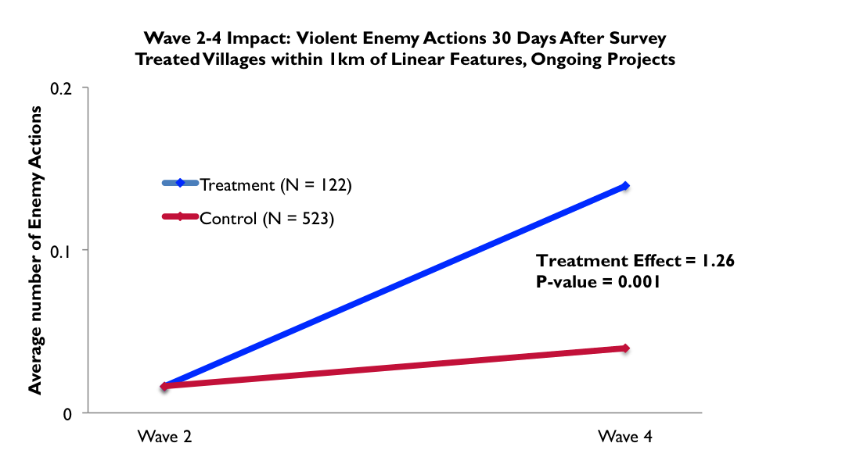
Stabilization Projects Attracted Violence
Notes:
Stabilization programming resulted in an increase in the number of violent incidents in the treatment group compared to the control group in Waves 2-4. The findings show that Taliban and other armed opposition groups target attacks at villages because of stabilization interventions. This violence is an effective strategy for reducing the impact of stabilization interventions.
These findings have the policy implication that program implementers should carefully weigh the risk to local beneficiaries before intervening with a project activity. Projects should engage security forces in the project where feasible.
Poisson regression on the raw violence counts was used to test whether interventions created a higher frequency of violent incidents in the treatment group compared to the counterfactual control group. Standard errors were adjusted for district clustering to control for bias that would arise from comparing villages in more violent districts with ones in less violent districts.

Slide 21
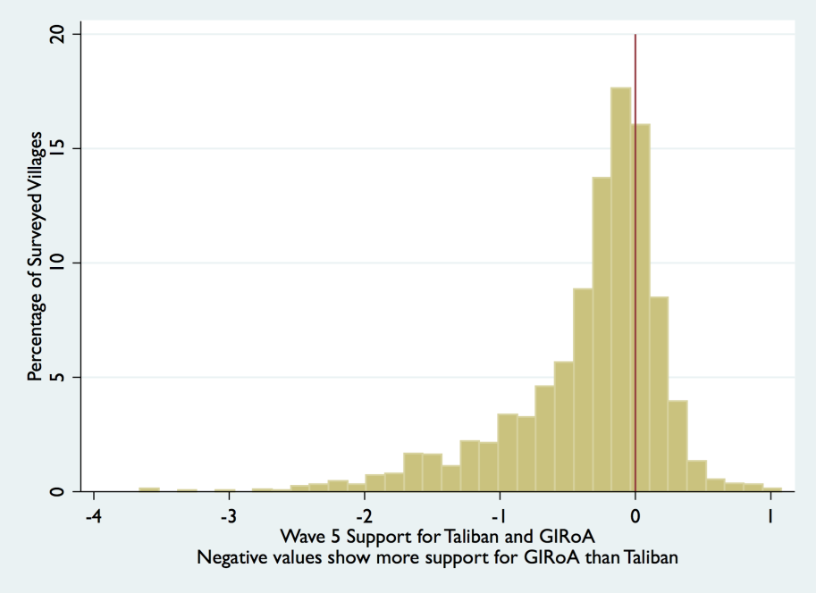
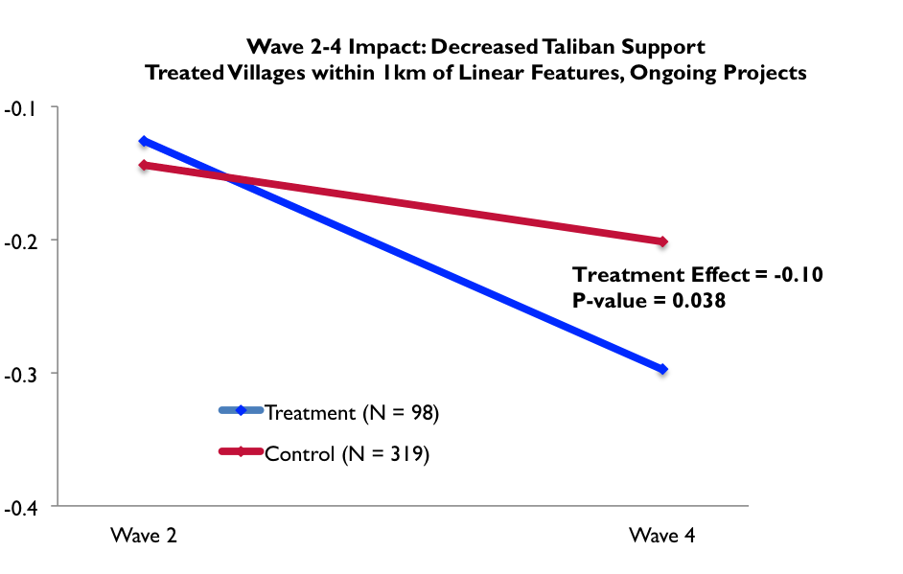
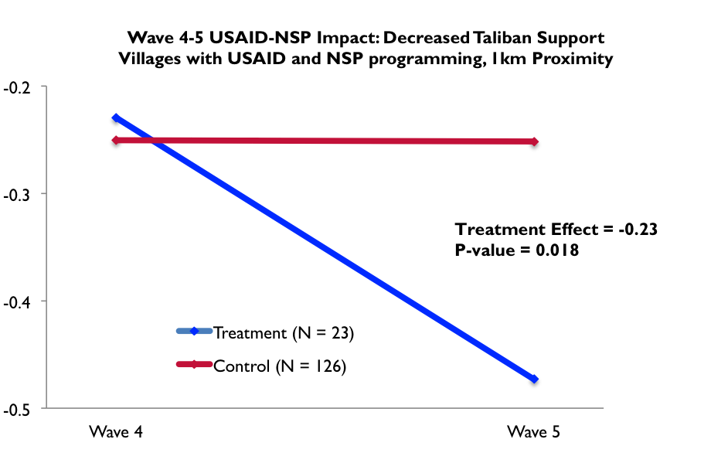
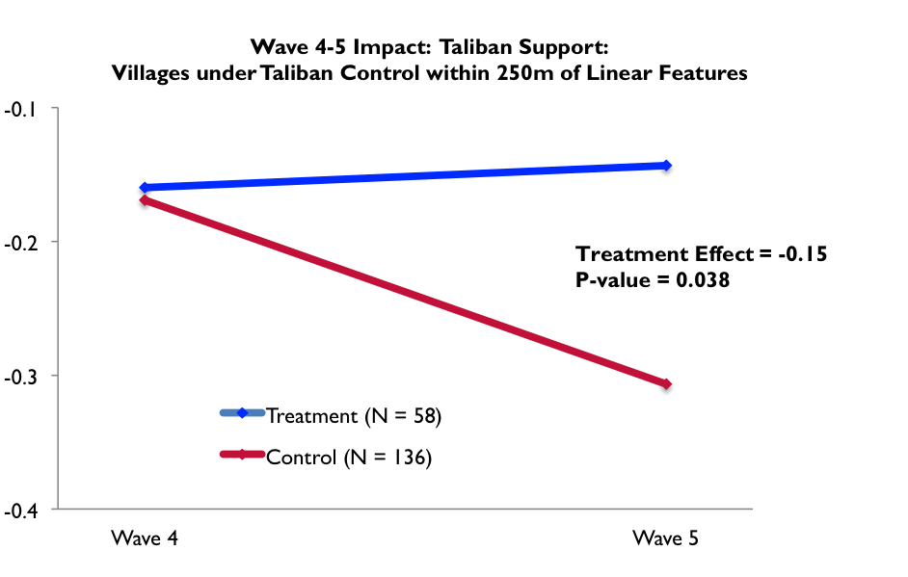
Endorsement Experiment
Notes:
The figures illustrate the findings of the survey endorsement experiment and the impact of USAID and NSP programming on relative support for the Taliban and GIRoA as follows:
The distribution of relative support for the Taliban and GIRoA across the villages surveyed in Wave 5 shows that more villages lean towards GIRoA than the Taliban, but the largest groups of villages were “on the fence,” such that they had approximately equal support for, or indifference towards both sides (top left);
The impact of ongoing stabilization project activities on decreasing support for the Taliban (top right);
The impact of ongoing project activities on increasing support for the Taliban in Waves 4-5 was driven by the inclusion of several Taliban-controlled villages in the treatment group matched to villages in the same district that were not Taliban controlled (bottom right);
The impact of USAID and NSP programming on decreasing support for the Taliban over six months from Waves 4-5 (bottom left).
Relative support had not shifted significantly towards one side or the other over the 2.5 years covered. Indeed the average respondent was somewhat supportive of both sides. This suggests that reconciliation between the parties in the conflict is possible and necessary at the local level as well as nationally. Programming in Taliban controlled villages requires a strategy to ensure that GIRoA is credited for the benefits that accrue to the community.

Slide 22
Endorsement Experiment Takeaways
Women and literate people were least supportive of the Taliban. “Soft” programming to improve literacy and empower women is likely to have a greater impact on regime support than the most common, “hard” infrastructure-focused stabilization activities.
Household income had no statistically significant relationship with support for the Taliban or GIRoA. The correlation between income and relative support varied between weakly positive or weakly negative depending on the survey wave. This finding reinforces the importance of designing stabilization activities such that income generation is linked to good governance.

Slide 23
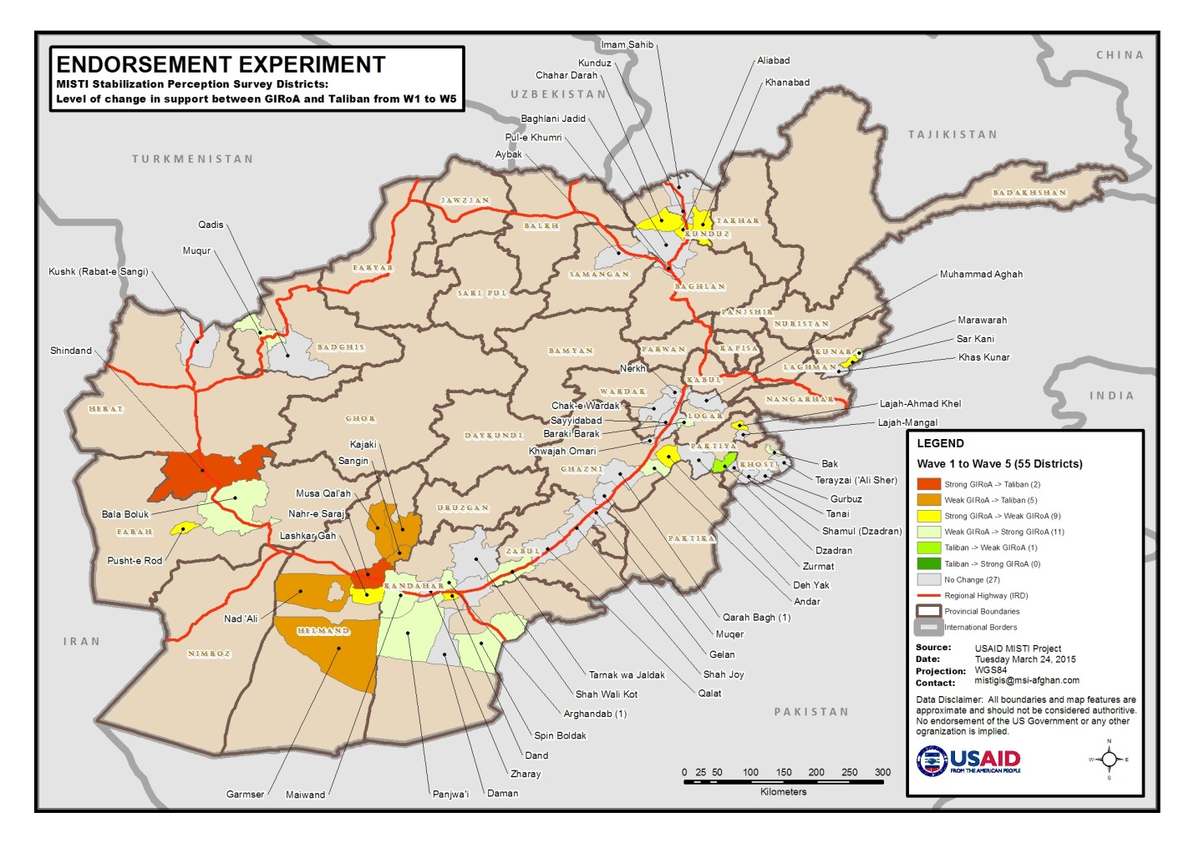
Change in Taliban Support by District

Slide 24
Unanswered Questions
How were impacts in Taliban-controlled villages achieved?
To what extent was talking to the Taliban necessary for achieving program impacts?
Under what conditions was violence used against project villages?
How did violence affect relative support for the Taliban and GIRoA?
To what extent was the “ink-spot” tactic in counterinsurgency used by stabilization programming and was it impactful?
Was the National Solidarity Program effective for stabilization?

Slide 25
Performance Evaluations
Findings
The SIKAs lacked a properly articulated theory of change. CCI was not able to articulate one.
KFZ’s scope, timeframe and funding were inadequate, leading to limited ability to program.
A decentralized approach to implementation led to disparate programming approaches.
Programming sometimes occurred in areas lacking a willing government partner.
Soft programming and capacity building had more significant effects than large infrastructure projects.
M&E units were mostly used as output indicator clearinghouses rather than programming evaluation tools.
Recommendations
Programs should have a properly articulated theory of change.
USAID should avoid using multiple IPs/CORs on multi-project programs.
Stabilization programming which aims to link government with local communities should take place in areas with a willing – albeit nascent – government presence.
A greater proportion of soft activities should be implemented and tied to infrastructure development.
Internal M&E units should provide internal evaluations to adapt programming.
Notes:
Decentralized approach meant programming was often less about regional differences and more about COP and COR personalities
Often SIKA districts did not have an active district governor or civil servants present in the district offices to conduct linkage work.
Well trained internal monitoring teams can improve infrastructure completion rates. Programs should circulate best practices, like those in Helmand and Kushk, among all districts and provinces in program portfolios.
CCI M&E lacked the capacity to conduct proper project evaluations and report on progress towards objectives through more than aggregate grant information.
Third party monitors like MISTI are provide a program-level impact evaluation…not project-level assessments.

Slide 26
Stability Assessment Method (SAM)
Findings
The SAM approach (community participation model based on identifying SOI) was too complex and culturally inappropriate for most rural Afghan communities. The CCI approach -- working with Cohesion Jirgas and through Project Shuras to prioritize projects -- was more appropriate and effective.
SAM had the unintended consequence of strengthening local leaders over subnational government.
SAM did not allow for equitable programming across areas.
Recommendations
Stabilization programming should be based on less of a community participation approach and more on a government led approach that is consensus driven with local leadership and accounts for local needs as well as identified SOI.
Government should be more engaged in driving stabilization programming decisions.
Stabilization programming in unstable areas should be coordinated with traditional development programming in neighboring areas so the government is not viewed as only rewarding unstable communities.

Slide 27
Verifications
Findings
Rates of incomplete infrastructure (i.e., when MISTI did not find any activity or could only find a portion of the activity) vary considerably across and within projects - see chart on next slide.
Linear features are more likely to be partially completed compared to fixed infrastructure.
1/3 of SIKA South projects are incomplete, many of which are high-cost, complex infrastructure projects.
Recommendations
Improve the training of internal monitoring teams to improve infrastructure completion rates.
Monitor linear feature length by using GPS devices and confirming with ArcGIS and updated imagery.
M&E teams should prioritize monitoring of high-cost, complex projects over low-cost, less complex projects.
Lessons Learned
Third-party monitors cannot verify projects without useable GPS coordinates.
Monitors must come from the provinces they are monitoring.
Verification is not only a data collection exercise, it improves IP monitoring performance.
IPs should take extra care to monitor underground structures, e.g., some karezes and canals projects, during construction as they can be very difficult to verify post-construction.
To the best of their ability, IPs should provide fixed times and locations for soft projects, e.g., trainings.
Notes:
Completion rates vary widely within programs. In SIKA South, for example, Kandahar has many incomplete projects while Helmand has relatively few. The same applies at the district level: SIKA-West’s Bala Boluk has many more failed verifications than Kushk.
Long linear features like roads and canals are more likely to be incomplete compared to fixed infrastructure because project length is found to be shorter than reported.
Well trained internal monitoring teams can improve infrastructure completion rates. Programs should circulate best practices, like those in Helmand and Kushk, among all districts and provinces in program portfolios.
By and large, verification results improved over time as IPs used MISTI’s monitoring recommendations to highlight weaknesses and make course corrections.

Slide 28
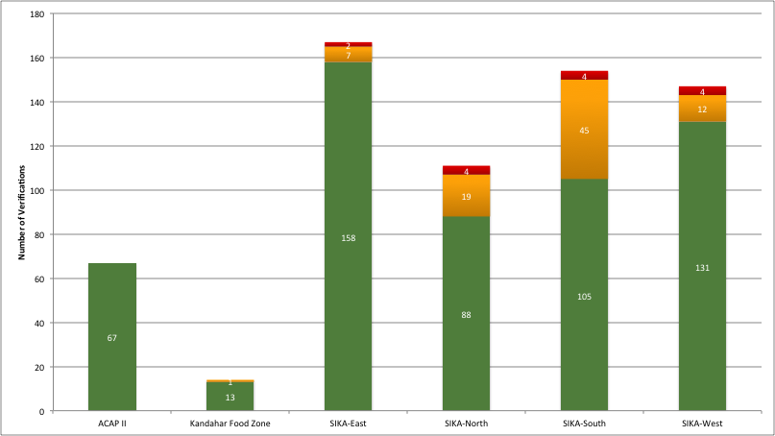
Project Activity Execution Rates: By Project
Executed as Reported
Executed with Conditions
Not Executed
Notes:
Completion rates vary widely across and within programs. In SIKA South (ca.1/3 of all projects improperly executed), for example, Kandahar province has many incomplete projects while Helmand province has relatively few. The same applies at the district level: SIKA-West’s Bala Boluk has many more failed verifications than Kushk.
Project Executed as Reported (Green): If a project is completed 100% as described.
Project Executed with Conditions (Yellow): If only a portion of the project can be verified. 1%-99% completed.
Project Not Executed (Red): If nothing can be found at the reported project site. 0% completed.
MISTI has verified 40% of all SIKA infrastructure projects, totaling (with trainings and other verified soft activities) $17.6 million of USAID stabilization and governance programming funds. As of 30 June: SIKA East 37% (167 verifications), SIKA South 38% (154), SIKA West 56% (147), SIKA North 34% (111). ACAP II – 67 verifications. KFZ – 14 verifications.
Validation approximately 7%

Slide 29
MISTI Lessons Learned
Project Environment
Implementation letters must be agreed before project start-up.
USAID should notify IPs well in advance if there will be a project extension.
Vetting delayed efforts to ensure quick delivery interventions.
Data Quality and Standardization
Standardized project trackers and grants activities databases (standard spreadsheet, categories, definitions, etc.) should be used on multi-project programs like SIKA.
USAID and IPs should use common geospatial datasets, e.g., district and provincial boundary datasets, naming conventions, population estimates.
IPs should use a relational database , e.g., SQL or MS Access, for better QA, querying, and reporting.
GPS coordinates of project activities must be collected at the project site using a GPS device. Multiple coordinates need to be collected for linear features (e.g., roads) and grants with multiple activities.
MOUs should be established between the Agency and its counterparts for the sharing of data.
USAID should maintain a catalogue of data sources available to IPs with descriptions each of source and what it could be useful for based on a proper QA/QC of the data.
Notes:
The letters that state what ministry (and what department) is responsible for overseeing programming must be agreed before project start-up. They should clearly state the parties’ particular responsibilities, deliverables, communication channels, and necessary coordination activities.
Last-minute notices considerably inhibit performance, result in loss of (difficult to replace) staff, and force IP management to unnecessarily focus on closing out the project.
Standardization improves the ability to perform quality assurance of the data (internal and third party), query the data, create a consolidated tracker/database, use the data for M&E and verification purposes, and allows greater opportunities for analysis and learning.
Other data quality issues caused by a lack of standardization include the mismatching of grant titles and assigned sectors, coordinates with typos or symbols added, different coordinate formats used (decimal degrees, DMS, etc.), and budgets are reported at grant level rather than activity level (one grant may include multiple activities, e.g., one road construction grant may include one road, three bridges and 12 culverts). Tracker databases are too prone to human data entry error and should have drop down menus to restrict entry error.
Easiest way to QA data on GPS coordinates is to plot the coordinates on satellite imagery and/or Afghanistan boundaries. First thing MISTI did to identify the rubbish -- very quick and easy. If a point appeared outside of Afghanistan or in the middle of non-populated areas (top of ridges or in desert) these are obviously incorrect. IPs M&E/GIS departments should have done this internally before sharing coordinates…obviously no QA was ever done on the coordinates prior to MISTI Verification.
IPs should use a relational database , e.g., SQL or MS Access, better for QA, data querying, and reporting.

Slide 30
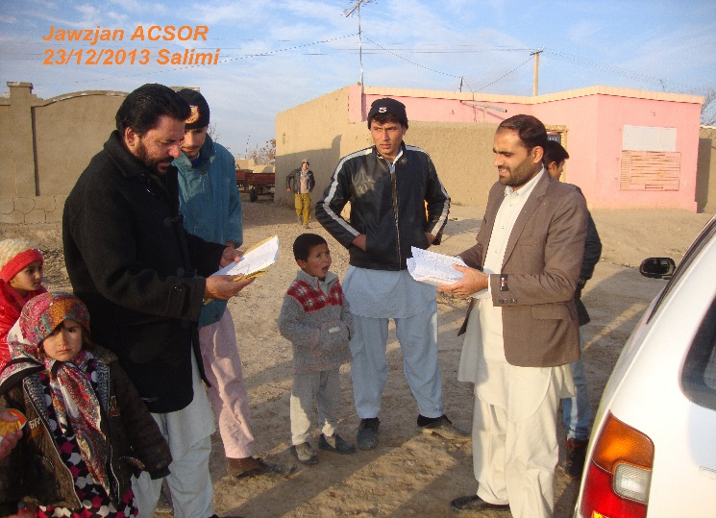
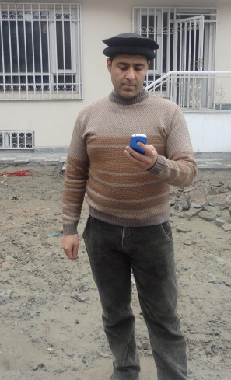

MISTI Lessons Learned (cont’d)
Data Collection and Analysis
It is possible to use smartphones with various applications to accurately track the progress of activities.
Data collection should be performed by locals familiar with the area and people living there.
Projects involving impact evaluations should conduct peer reviews of their data collection and analytical methods.
Notes:
MISTI used open source software to develop Android mobile applications for navigating onto activity locations, collecting data using digital forms (ODK), taking GPS DTG stamped photos, and automatically uploading data to the MISTI server. IPs should also make use of these technologies for monitoring activities.

Slide 31

Questions?

